Slide 1
Data Analysis Tools Analytics (Data Analytics using Machine Learning)
Presented To: Prof. Sk. Md. Mizanur Rahman Presented By: Shubh Jala (100953844)
Krunal Patel (100955996)
Prabal Pratab Singh(100912919)

Slide 2
Dataset Overview
Dataset Overview:
Total Instances: 100,000, split equally into two categories: Malware and Benign, each with 50,000 entries.
Features: 34 features are included, combining both numerical and categorical data.
Class Distribution:
Malware: 50,000 (50%)
Benign: 50,000 (50%)
Key Insight: The dataset is fully balanced, making it ideal for classification tasks with no bias toward either category.

Slide 3
Dataset Overview
Columns/Features: The dataset includes features that represent key properties important for distinguishing Malware from Benign samples. Preprocessing steps should ensure:
Numerical Scaling: Standardizing numerical data if needed.
Categorization: Properly encoding categorical variables.
Target Column:
Classification: Contains two labels – Malware and Benign.
File Format:
The data is provided in .csv format and can be processed using tools like Pandas.
Data Insights:
Ensure there are no missing values in the dataset. This should be verified during preprocessing.
During training, classes should grow evenly without favoring one over the other to maintain balance.

Slide 4
Dataset Preprocessing
Balancing the Dataset:
Majority Class:
Includes all rows labeled as Benign, compiled from the SCRN data.
Minority Class:
Consists of all rows labeled as Malware, extracted automatically based on the classification.
Upsampling:
To equalize the size of the minority class (Malware) with the majority class (Benign), resampling was applied.
Parameters Used:
replace=True: Allows creating duplicate entries for the minority class.
n_samples: Matches the number of samples in the majority class.
random_state=42: Ensures the process can be repeated consistently.
Outcome:
Malware and benign entries are now in equal proportions, ensuring a balanced dataset.
Combining Classes:
The oversampled Malware data and the original Benign data were merged using pd.concat() to form a new, balanced dataset named balanced_df

Slide 5
Dataset Splitting
Features (X): All columns, except the classification column, were used as the feature set.
Target (y): The classification column served as the target variable.
Data Split: The dataset was split into training (70%) and testing (30%) sets using train_test_split.
Parameters Used:
test_size=0.3: Allocates 30% of the data for testing.
random_state=42: Ensures reproducibility of the split.
Result:
Training Instances: 70,000
Testing Instances: 30,000

Slide 6

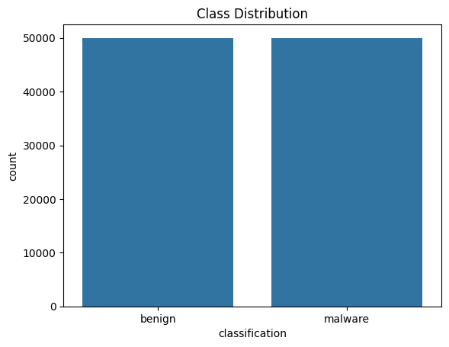
Exploratory Data Analysis (EDA) - Class Distribution
Class Distribution:
A bar chart illustrates that both classes, Benign and Malware, have 50,000 instances each, confirming the dataset is perfectly balanced.
Why Balance Matters:
In an imbalanced dataset, the model tends to favor the majority class, leading to biased predictions. A balanced dataset ensures the model learns about both classes equally, resulting in fair and accurate classifications.
Key Takeaway:
The bar chart confirms that resampling during preprocessing worked as intended. Both classes now have equal representation, ensuring the model won't be biased toward one class over the other.

Slide 7

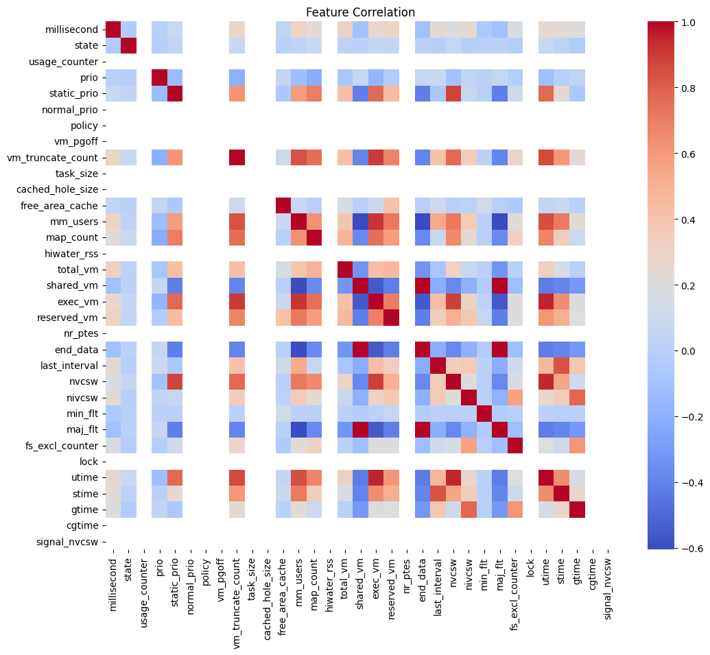


Slide 8
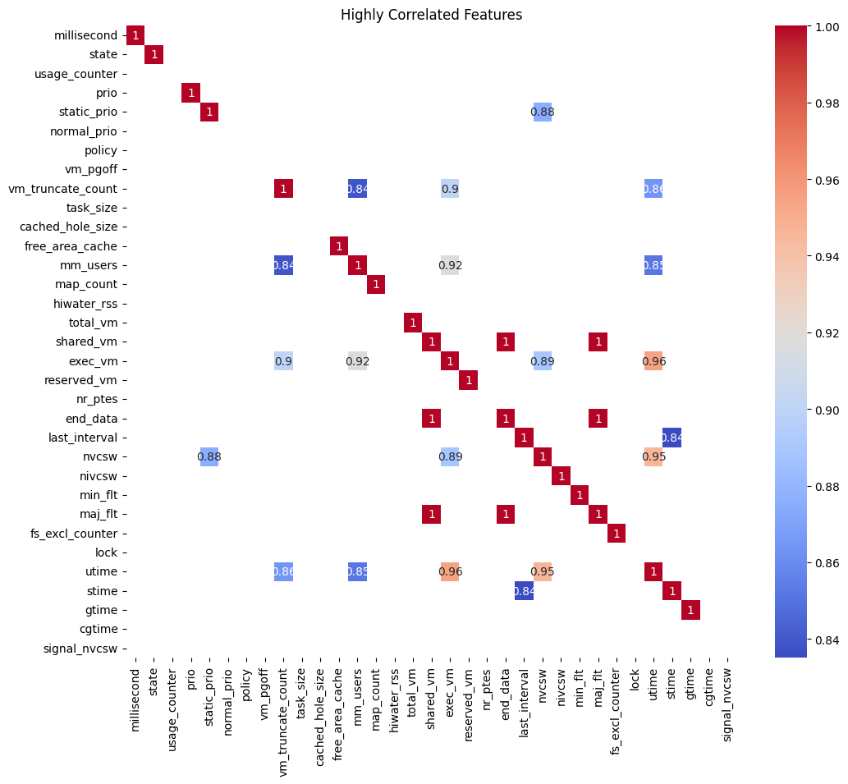

Slide 9
Feature Correlation Analysis
General Correlation (First Heatmap):
Displays pairwise correlations between all features in the dataset.
Values range from -1 to 1:
1: Perfect positive correlation.
-1: Perfect negative correlation.
0: No correlation.
The heatmap reveals areas with strong correlations (bright red) and weak/no correlations (blue).
Highly Correlated Features (Second Heatmap):
Filters and highlights features with a correlation above 0.8 or below -0.8.
Examples of strong correlations:
shared_vm and total_vm: Correlation = 0.92.
map_count and mm_users: Correlation = 0.84.
stime and utime: Correlation = 0.96.
Highly correlated features may indicate redundancy, which could affect model performance.

Slide 10
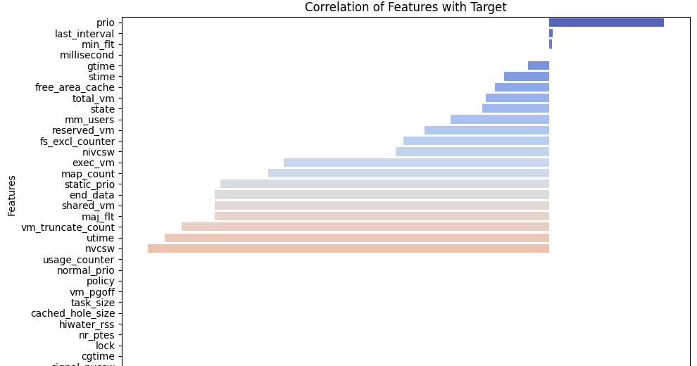

Slide 11
Feature Correlation with Target Variable
Positive Correlation:
Features with positive coefficients (e.g., prio, last_interval) contribute positively to predicting the target.
prio has the strongest positive correlation.
Negative Correlation:
Features with negative coefficients (e.g., signal_nvcsw, cgtime) contribute negatively to predicting the target.
signal_nvcsw has the strongest negative correlation.
Magnitude of Correlation:
Correlation values closer to -1 or 1 indicate stronger relationships.
Features with values near 0 (e.g., task_size, vm_pgoff) have minimal impact on predictions.
Key Takeaways:
Top Features:
prio and last_interval are critical for distinguishing between benign and malware.
Low-Impact Features:
Features with near-zero correlation may have limited utility and could be dropped or reviewed further.
Feature Selection:
Focus on strongly correlated features while considering removal or merging of weaker ones.

Slide 12
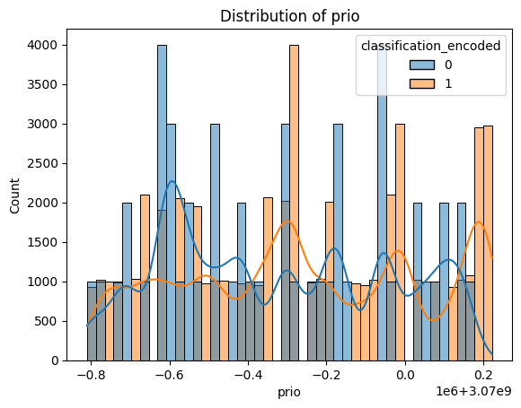
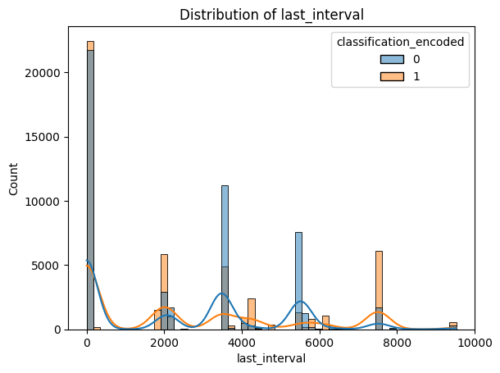

Slide 13
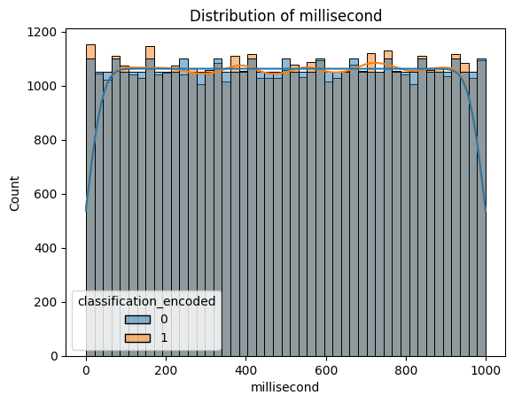
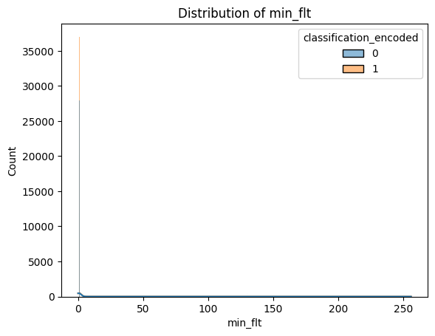

Slide 14
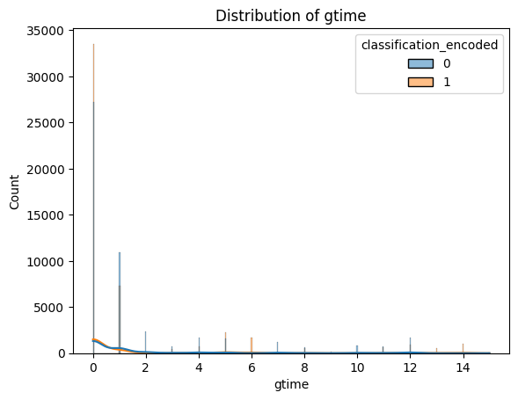

Slide 15
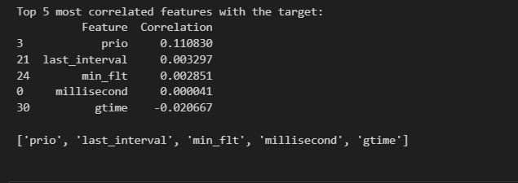
Top 5 Correlated Features
Feature Correlations:
prio: 0.11 (highest positive correlation, potentially important).
last_interval: 0.02.
min_flt: 0.002.
millisecond: 0.00004.
gtime: -0.02 (negative correlation).
Insights:
prio shows the strongest positive correlation, suggesting it might be useful for distinguishing between benign and malware.
The other features have very low correlation values, indicating a weak direct relationship with the target variable and potentially less impact on prediction.

Slide 16
Feature Distributions
prio:
The histogram shows significant overlap between classes.
Peaks in the data suggest a possible discrete or grouped pattern.
last_interval:
Data is clustered near low values, especially around 0.
Class distributions (0 and 1) show some separation with spikes at specific intervals.
min_flt:
Most values are 0 for both classes, with occasional higher values.
Low variability suggests it may have limited influence on classification.
millisecond:
Displays a uniform distribution for both classes.
Minimal separation between benign and malware, indicating low predictive potential.
gtime:
Data is highly skewed toward 0.
Minimal separation between classes, making it less useful for classification tasks.

Slide 17
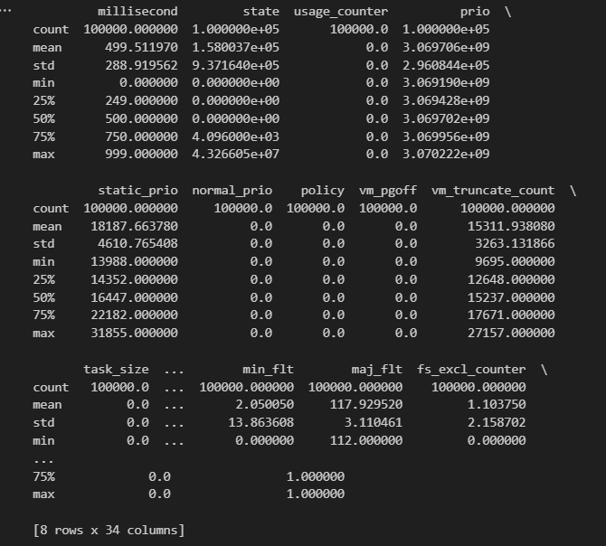
Summary Statistics
Count:
All features have 100,000 instances, confirming there are no missing values in the dataset.
Mean and Standard Deviation:
Features like prio, vm_pgoff, and state have high mean values, indicating they may have larger numerical scales.
Features like min_fit and max_fit have smaller ranges, hinting at categorical or binary values.
Min and Max Values:
min_fit ranges from 0 to 1, confirming it is binary.
Features like prio and state span larger numerical ranges, requiring attention to scaling.
Key Insights:
Numerical Scaling: Ensure all numerical features are properly scaled for machine learning models to avoid biases caused by differing ranges.
Binary Features: Binary features (e.g., min_fit, max_fit) might need encoding when used with models like decision trees.

Slide 18
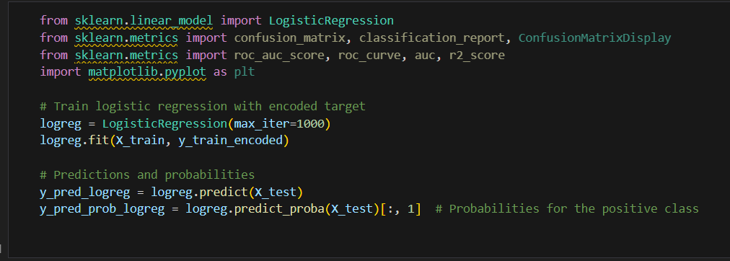
Logistic Regression
Logistic Regression Overview:
A classification algorithm used to predict the probability of a binary outcome: Benign (0) vs Malware (1).
Evaluates performance using metrics like accuracy, precision, recall, and AUC (Area Under the Curve).
Model Training Details:
Training Dataset:
70% of the dataset was used for training the model.
Preprocessing:
Feature Scaling: Ensured numerical features were scaled properly.
Target Encoding: Target labels were encoded as 0 (benign) and 1 (malware).
Model Configuration:
Logistic Regression configured with max_iter=1000 to guarantee convergence.

Slide 19
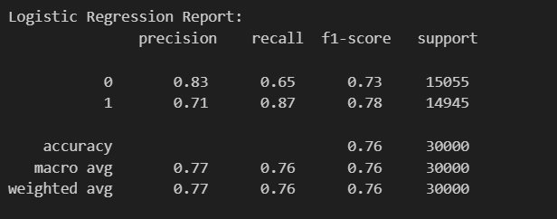
Model Performance
Classification Metrics:
Accuracy: 0.76
Precision:
Class 0 (benign): 0.83
Class 1 (malware): 0.71
Recall:
Class 0 (benign): 0.65
Class 1 (malware): 0.87
F1-Score:
Class 0 (benign): 0.73
Class 1 (malware): 0.78

Slide 20
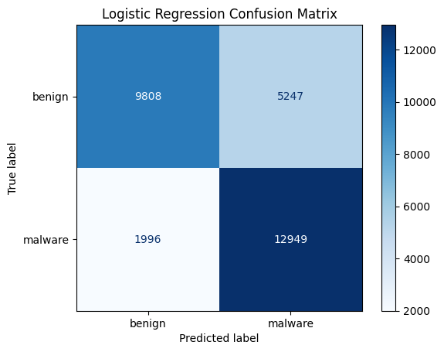
Model Performance
Confusion Matrix
True Positives (malware identified correctly): 12,949
True Negatives (benign identified correctly): 9,808
False Positives: 1,996
False Negatives: 5,247

Slide 21
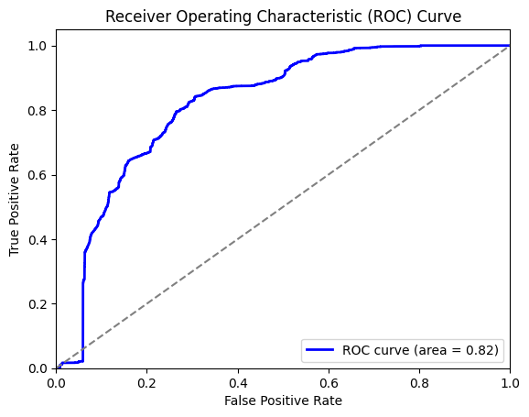
ROC Curve and AUC
ROC Curve:
Visualizes the balance between sensitivity (true positive rate) and specificity (true negative rate).
AUC (Area Under Curve): 0.82, showing good but not perfect class separability.
R² Score:
Value: 0.034, indicating limited predictive strength.
Key Observations:
Class Performance:
The model performs better at identifying malware (Class 1) than benign (Class 0).
False Negatives:
Higher false negatives for benign samples suggest room for improvement in balancing predictions.
Precision & Recall:
Indicates the need to better align sensitivity (catching positives) with specificity (avoiding false positives).

Slide 22
Random Forest Classifier
A Random Forest is an ensemble learning method that builds multiple decision trees and combines their predictions for improved accuracy and robustness.
Supervised Learning: Primarily used for classification and regression tasks.
A classification problem: Predicting whether software is malware or benign.
Trained the model on preprocessed data using 10 decision trees with a maximum depth of 10.
Evaluated the model using metrics like classification report, confusion matrix, cross-validation scores, and feature importance.

Slide 23

Steps in the Process
Data Loading and Cleaning
Removed the non-informative column (hash).
Separated features and target variable (classification).
Data Preprocessing
Scaled features using StandardScaler to normalize data.
Model Training
Trained a Random Forest classifier with 10 estimators and a maximum depth of 10.
Performance Evaluation
Evaluated performance using a classification report, confusion matrix, cross-validation, and feature importance analysis.

Slide 24
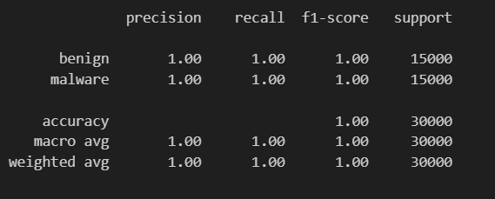
Visualization and Results
Observations:
Precision, Recall, and F1-Score: 1.00 for both classes (benign and malware).
Overall Accuracy: 1.00 (indicating excellent model performance)

Slide 25
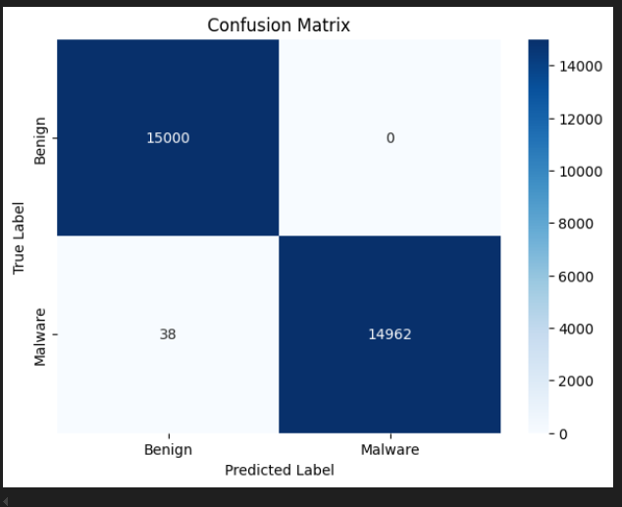
Visualization and Results
Observations:
Minimal misclassifications: Only 38 malware samples were incorrectly classified as benign.

Slide 26

Interpretation of Results
High Accuracy and Recall:
The model excels at identifying malware, with outstanding precision and recall, effectively minimizing false negatives.
Model Robustness:
Cross-validation average score: 0.9999, showing consistent performance across various data splits.
Feature Importance:
Key contributors include static_prio, free_area_cache, and utime, which significantly impact classification.
Limitations:
The near-perfect scores suggest potential overfitting, which could affect generalizability to new data.

Slide 27
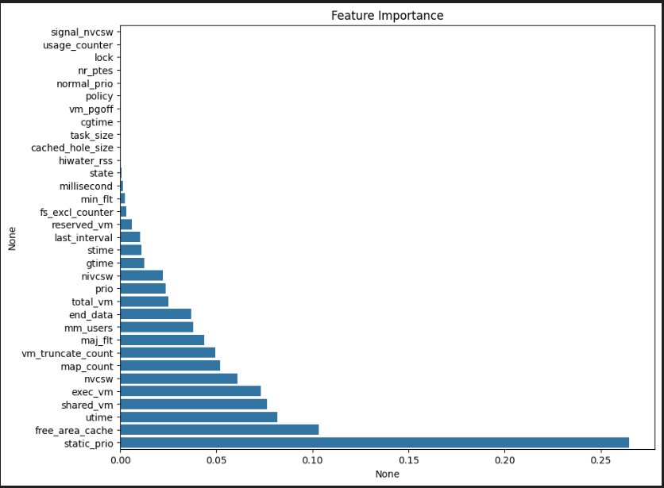
Feature Importance

Slide 28
Neural Network for Malware Classification
A neural network is a machine learning model inspired by the human brain, capable of learning complex patterns from data by adjusting weights through multiple layers.
Neural networks can be used for both, Supervised Learning and Unsupervised Learning.
This is a classification problem, where the goal is to predict whether software is malware (1) or benign (0).
Trained the model to minimize errors by propagating loss backward through the network and updating weights over 1000 epochs.

Slide 29
Steps in the Process
Data Loading and Cleaning:
Loaded the dataset and removed non-informative features.
Data Preprocessing:
Scaled features and encoded the target variable.
Model Initialization:
Designed a neural network with one hidden layer and specified parameters.
Training the Model:
Used forward and backward propagation over 1000 epochs to optimize the weights.
Performance Evaluation:
Visualized training loss and calculated accuracy on the test set.

Slide 30
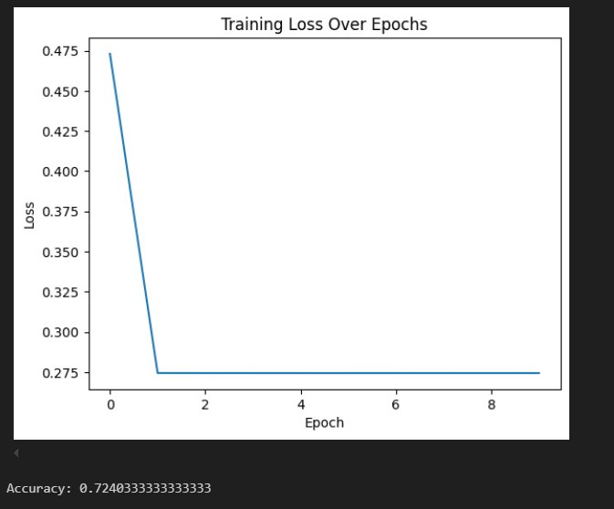
Visualization and Results
Demonstrates how the model minimized the error over 1000 iterations.
Performance Metrics:
Final Loss: 0.2743
Accuracy: 72.4%
Observations:
The network effectively distinguished malware from benign files, achieving moderate accuracy.
The steady decrease in loss shows successful learning during training.

Slide 31
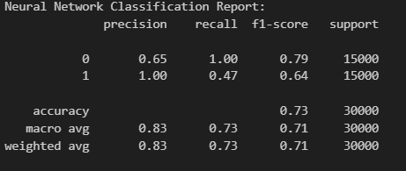
Interpretation of Results
High recall (1.00) for benign samples indicates the model successfully identifies benign files.
Poor recall (0.47) for malware shows the model misses many malware samples, which is critical for this problem.
Weighted average F1-Score: 0.71, indicating moderate overall performance.
Accuracy (72.4%) indicates the model performs better than random guessing but has room for improvement.
Accuracy could be improved with additional data or model tuning.

Slide 32
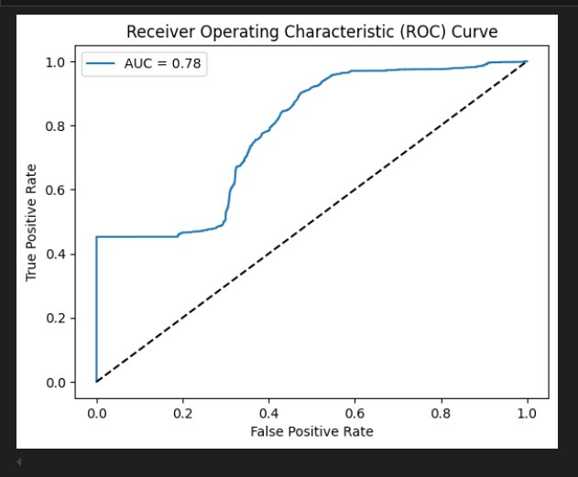
AUC-ROC Curve
The Receiver Operating Characteristic (ROC) curve illustrates the balance between the True Positive Rate (TPR) and False Positive Rate (FPR) at different classification thresholds.
AUC (Area Under the Curve):With an AUC score of 0.78, the model demonstrates a 78% likelihood of correctly distinguishing between malware and benign files.
Shows the model's capability to minimize false positives while maximizing true positives.
The ROC curve bends towards the top-left corner, indicating strong performance.

Slide 33
Naive Bayes
A probabilistic classification algorithm based on Bayes' theorem, assuming independence between features.
Supervised Learning: Used for classification tasks.
A binary classification problem where the goal is to classify software as either malware (1) or benign (0).
Applied Gaussian Naive Bayes to predict the target variable (classification).
Trained the model on preprocessed and scaled data, focusing on minimizing classification errors.

Slide 34
Steps in the Process
Data Loading and Cleaning
Removed non-informative column (hash).
Converted categorical target to binary format (malware/benign).
Data Preprocessing
Split dataset into training and testing sets.
Scaled features using StandardScaler for better model performance.
Model Training
Used Gaussian Naive Bayes to train the classifier on the training set.
Performance Evaluation
Evaluated performance using precision, recall, F1-score, and AUC-ROC.

Slide 35
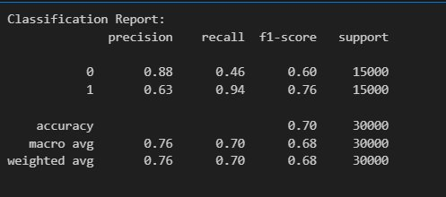
Visualization and Results
Classification Report:
Precision: Measures how many predicted malware cases were correct.
Recall: Measures how many actual malware cases were identified.
F1-Score: Harmonic mean of precision and recall.
Accuracy: 70%
Observations:
Model has higher recall for classifying malware (0.94), which is critical for detecting malware.

Slide 36
Interpretation of Results
High Recall for Malware Detection:
Recall of 0.94 indicates the model is effective in identifying malware, minimizing false negatives.
Lower Precision for Malware:
Precision of 0.63 shows some false positives, which can be improved with more features or tuning.
Overall Model Performance:
With an accuracy of 70% and balanced F1-scores, the model performs well but can benefit from further optimization.

Slide 37
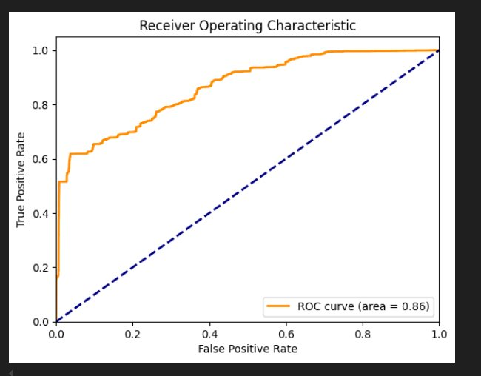
AUC-ROC Curve
ROC Curve: Shows the trade-off between True Positive Rate (TPR) and False Positive Rate (FPR) at various thresholds.
AUC Score: 0.86
Indicates the model has an 86% chance of correctly distinguishing between malware and benign files.
The AUC-ROC score reflects good model performance, suitable for binary classification tasks.

Slide 38



K-Nearest Neighbors (KNN)
KNN is a simple, instance-based supervised learning algorithm. It predicts the class of a sample by looking at the majority class among its K nearest neighbors in the feature space.
Supervised Learning: Used for both classification and regression tasks.
This is a classification problem: predicting whether software is malware (1) or benign (0).
Preprocessed and scaled data to ensure all features contribute equally.
Evaluated model accuracy across different values of K (number of neighbors) to identify optimal performance.

Slide 39
Steps in the Process
Data Loading and Cleaning
Removed the non-informative hash column.
Converted the target variable (classification) to binary format.
Data Preprocessing
Scaled features using StandardScaler to normalize data.
Model Training
Trained a KNN model for multiple values of K (from 1 to 25).
Performance Evaluation
Calculated accuracy for each value of K and visualized results.

Slide 40
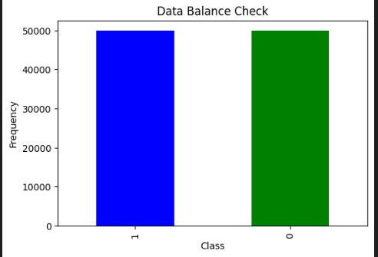
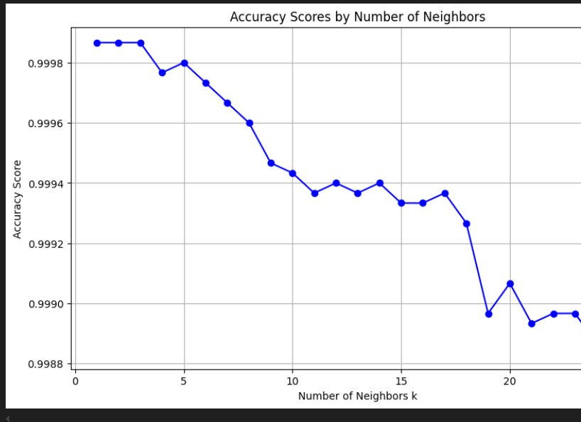
Visualization and Results
Data Balance Check:
The dataset is balanced with an equal number of benign and malware samples.
Accuracy is very high for smaller values of K (up to 0.9999 for K=1 and K=2).
Accuracy slightly decreases as K increases.

Slide 41
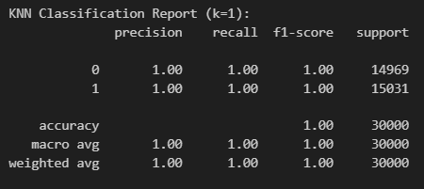
Visualization and Results
Accuracy: 100%
Classification Report:
Benign (Class 0): Precision: 1.00, Recall: 1.00, F1-Score: 1.00
Malware (Class 1): Precision: 1.00, Recall: 1.00, F1-Score: 1.00
Macro Avg: Precision: 1.00, Recall: 1.00, F1-Score: 1.00
Observations
Perfect performance across all metrics (no misclassifications).
Strength: Ideal for this dataset with 100% accuracy.
Limitation: Computationally expensive for large datasets.

Slide 42
Interpretation of Results
Key Insights:
Optimal Performance: The model performs best for smaller K values (K=1 and K=2), achieving an accuracy of nearly 99.99%.
Accuracy Drop: As K increases, the model becomes more generalized, resulting in a slight drop in accuracy.
A lower K value (e.g., K=1 or K=2) is ideal for this dataset, as it better captures the local patterns in the data.
Higher K values may lead to overgeneralization, reducing the model’s sensitivity to subtle variations.

Slide 43
Comparison Performance Metrics
Algorithm | Accuracy | Precision | Recall | F1-Score | AUC-ROC | Comments
Logistic Regression | 76% | 0.83 (Benign), 0.71 (Malware) | 0.65 (Benign), 0.87 (Malware) | 0.73 (Benign), 0.78 (Malware) | 0.82 | Balanced performance; suitable for interpretable and simple models.
Random Forest | 99.99% | 1.00 (All) | 1.00 (All) | 1.00 (All) | 1.00 | Perfect performance; most robust model for this dataset.
KNN (k=1) | 100% | 1.00 (All) | 1.00 (All) | 1.00 (All) | 1.00 | Identical to Random Forest; computationally expensive for large datasets.
Neural Network | 73.42% | 0.65 (Benign), 1.00 (Malware) | 1.00 (Benign), 0.47 (Malware) | 0.79 (Benign), 0.64 (Malware) | 0.78 | Moderate performance; high recall for benign but poor recall for malware.
Naive Bayes | 70% | 0.88 (Benign), 0.63 (Malware) | 0.46 (Benign), 0.94 (Malware) | 0.60 (Benign), 0.76 (Malware) | 0.86 | Good recall for malware detection but struggles with benign precision.

Slide 44
Conclusion
Random Forest is the most robust and reliable model for this dataset.
KNN (k=1) matches Random Forest in performance but is computationally expensive for larger datasets.
For simpler and more interpretable models, Logistic Regression is a viable alternative.
Further optimization of Neural Networks may improve their balance between precision and recall, making them a competitive choice.

Slide 45


Thankyou

